Slide 1
Software Quality Assurance and Testing Technology
2nd Semester, Spring 2022
Haiming Liu
School of Software Engineering
Beijing Jiaotong University
Monday, May 16, 2022

Slide 2

Data Flow Testing
Example 1 (If condition):
What are the All-defs, All-uses, All-du-Paths for the program below?
1: read (z)
2: x = 0
3: y = 0
4: if (z ≥ 0)
5: {
6: x = sqrt (z)
7: if (0 ≤ x && x ≤ 5)
8: y = f (x)
9: else
10: y = h (z)
11: }
12: y = g (x, y)
13: print (y)
【腾讯文档】Data Flow Testing 1
https://docs.qq.com/form/page/DSHpsR3BLTFdYQkhX
Notes:
【腾讯文档】Data Flow Testing 1
https://docs.qq.com/form/page/DSHpsR3BLTFdYQkhX

Slide 3
Example 1 (If condition):
What are the All-defs, All-uses, All-du-Paths for the program below?
1: read (z)
2: x = 0
3: y = 0
4: if (z ≥ 0)
5: {
6: x = sqrt (z)
7: if (0 ≤ x && x ≤ 5)
8: y = f (x)
9: else
10: y = h (z)
11: }
12: y = g (x, y)
13: print (y)
1
2
3
4
5
6
7
8
9
10
11
12
13
Notes:
Adu x 678 679101112 ?
Adu y

Slide 4
Example 1 (If condition):
All-defs for X
What are the All-defs, All-uses, All-du-Paths for the program below?
1: read (z)
2: x = 0
3: y = 0
4: if (z ≥ 0)
5: {
6: x = sqrt (z)
7: if (0 ≤ x && x ≤ 5)
8: y = f (x)
9: else
10: y = h (z)
11: }
12: y = g (x, y)
13: print (y)
1
[ 2,12]
[6,7]
2
def X
3
All-uses for X
4
5
[ 2,12]
[6,7]
[6,7,8]
6
def X
7
use X
use X
All-du-paths for X
8
9
[ 2,12]
[6,7]
[6,7,8]
[6,7,8,11,12]
[6,7,9,10,11,12]
10
11
12
use X
13
Notes:
Adu x 678 679101112 ?
Adu y

Slide 5
Example 1 (If condition):
All-defs for Y
What are the All-defs, All-uses, All-du-Paths for the program below?
1: read (z)
2: x = 0
3: y = 0
4: if (z ≥ 0)
5: {
6: x = sqrt (z)
7: if (0 ≤ x && x ≤ 5)
8: y = f (x)
9: else
10: y = h (z)
11: }
12: y = g (x, y)
13: print (y)
1
[ 3,12]
[ 8,11,12]
[ 10,11,12]
[12,13]
2
3
def Y
4
5
All-uses for Y
6
[ 3,12]
[12,13]
7
8
9
All-du-paths for Y
def Y
[ 3,12]
[ 8,11,12]
[ 10,11,12]
[12,13]
10
def Y
11
def Y
12
use Y
13
use Y
Notes:
Adu x 678 679101112 ?
Adu y

Slide 6
Example 1 (If condition):
All-defs for Z
What are the All-defs, All-uses, All-du-Paths for the program below?
1: read (z)
2: x = 0
3: y = 0
4: if (z ≥ 0)
5: {
6: x = sqrt (z)
7: if (0 ≤ x && x ≤ 5)
8: y = f (x)
9: else
10: y = h (z)
11: }
12: y = g (x, y)
13: print (y)
1
def Z
[ 1,2,3,4]
2
All-uses for Z
3
[ 1,2,3,4]
[ 1,2,3,4,5,6]
[1,2,3,4,5,6,7,9,10]
use Z
4
5
6
use Z
7
8
9
All-du-paths for Z
[ 1,2,3,4]
[ 1,2,3,4,5,6]
[1,2,3,4,5,6,7,9,10]
10
use Z
11
12
13
Notes:
Adu x 678 679101112 ?
Adu y

Slide 7
Data Flow Testing
Example 2 (If + Loop):
What are the All-defs, All-uses, All-du-Paths for the program below?
【腾讯文档】Data Flow Testing 2
https://docs.qq.com/form/page/DSHdHSUJnUlZyeGxn
Notes:
【腾讯文档】Data Flow Testing 2
https://docs.qq.com/form/page/DSHdHSUJnUlZyeGxn

Slide 8
Example 2 (If + Loop):
What are the All-defs, All-uses, All-du-Paths for the program below?
1
1 void pow (int x, y)
2 {
3 float z;
4 int p;
5 if (y < 0)
6 p = 0 – y;
7 else p = y;
8 z = 1.0;
9 while (p != 0)
10 {
11 z = z * x;
12 p = p – 1;
13 }
14 if (y < 0)
15 z = 1.0 / z;
16 printf(z);
17 }
2
3
4
5
6
7
8
9
14
10
15
11
16
12
13
17

Slide 9
Example 2 (If + Loop):
What are the All-defs, All-uses, All-du-Paths for the program below?
All-defs for X
1
def X
[ 1,2,3,4,5,6,8,9,10,11]
1 void pow (int x, y)
2 {
3 float z;
4 int p;
5 if (y < 0)
6 p = 0 – y;
7 else p = y;
8 z = 1.0;
9 while (p != 0)
10 {
11 z = z * x;
12 p = p – 1;
13 }
14 if (y < 0)
15 z = 1.0 / z;
16 printf(z);
17 }
2
3
All-uses for X
4
[ 1,2,3,4,5,6,8,9,10,11]
5
6
7
8
All-du-paths for X
9
14
[ 1,2,3,4,5,6,8,9,10,11]
[ 1,2,3,4,5,7,8,9,10,11]
10
15
use X
11
16
12
13
17

Slide 10
Example 2 (If + Loop):
What are the All-defs, All-uses, All-du-Paths for the program below?
All-defs for Y
1
def Y
[ 1,2,3,4,5]
1 void pow (int x, y)
2 {
3 float z;
4 int p;
5 if (y < 0)
6 p = 0 – y;
7 else p = y;
8 z = 1.0;
9 while (p != 0)
10 {
11 z = z * x;
12 p = p – 1;
13 }
14 if (y < 0)
15 z = 1.0 / z;
16 printf(z);
17 }
All-uses for Y
2
3
[ 1,2,3,4,5]
[ 1,2,3,4,5,6]
[ 1,2,3,4,5,7]
[ 1,2,3,4,5,7,8,9,14]
4
5
use Y
6
7
use Y
use Y
All-du-paths for Y
8
use Y
[ 1,2,3,4,5]
[ 1,2,3,4,5,6]
[ 1,2,3,4,5,7]
[ 1,2,3,4,5,7,8,9,14]
[ 1,2,3,4,5,6,8,9,14]
[ 1,2,3,4,5,6,8,9,10,11,12,13,14]
[ 1,2,3,4,5,7,8,9,10,11,12,13,14]
9
14
10
15
11
16
12
13
17

Slide 11
Example 2 (If + Loop):
All-defs for Z
What are the All-defs, All-uses, All-du-Paths for the program below?
[ 8,9,10,11]
[ 11,12,13,9,10,11]
[15,16]
1
1 void pow (int x, y)
2 {
3 float z;
4 int p;
5 if (y < 0)
6 p = 0 – y;
7 else p = y;
8 z = 1.0;
9 while (p != 0)
10 {
11 z = z * x;
12 p = p – 1;
13 }
14 if (y < 0)
15 z = 1.0 / z;
16 printf(z);
17 }
2
3
def Z
All-uses for Z
[ 8,9,10,11]
[15,16]
[ 8,9,14,15]
4
5
6
7
All-du-paths for Z
8
def Z
[ 8,9,10,11]
[ 11,12,13,9,10,11]
[15,16]
[ 8,9,14,15]
[ 8,9,14,16]
[11,12,13,9,14,15]
[11,12,13,9,14,16]
9
14
10
def Z
15
use Z
def Z
11
16
use Z
use Z
12
13
17

Slide 12
Example 2 (If + Loop):
All-defs for P
What are the All-defs, All-uses, All-du-Paths for the program below?
1
[ 6,8,9]
[ 7,8,9]
[12,13,9]
1 void pow (int x, y)
2 {
3 float z;
4 int p;
5 if (y < 0)
6 p = 0 – y;
7 else p = y;
8 z = 1.0;
9 while (p != 0)
10 {
11 z = z * x;
12 p = p – 1;
13 }
14 if (y < 0)
15 z = 1.0 / z;
16 printf(z);
17 }
2
3
All-uses for P
4
def P
[ 6,8,9]
[12,13,9,11,12]
5
def P
6
7
def P
All-du-paths for P
8
use P
[ 6,8,9]
[ 7,8,9]
[12,13,9]
[12,13,9,11,12]
[6,8,9,10,11,12]
[7,8,9,10,11,12]
9
14
10
15
11
16
def P
use P
12
13
17

Slide 13
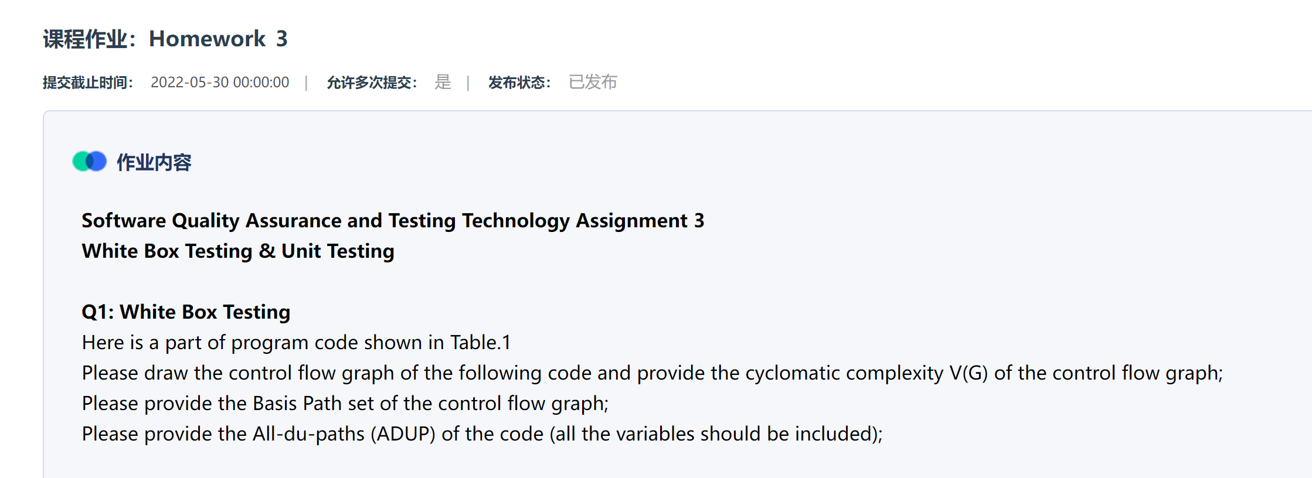
Homework_3

Slide 14
Review
Week 1: The basic concepts and theories of testing
Week 2-3: Principles of Testing
Week 4: Testing the specification
Week 5-6: Black Box Testing
Week 7-11: White Box Testing
Week 12: Integration Testing and System Testing
Week 13: Usability Testing and Accessibility Testing
Week 14: Security Testing
Week 13: Mutation Testing
Week 15: Software Quality
Week 16: Review I

Slide 15
OVERVIEW OF CLASSIFYING TESTS
BLACK-BOX: No knowledge of the internal logic of the code is utilized. Tests are based on requirements and functionality.
WHITE-BOX: Tests are designed based on the internal logic of the code, code coverage considerations, and analysis of branches, paths, loops, and conditions
UNIT: Test at the function or module level.
INCREMENTAL INTEGRATION: Continuous testing as new functionality is added. Testing combined parts of an application to see if the parts function together properly.
REGRESSION: Re-testing after fixes or modifications of software or the environment.

Slide 16
TEST PHASES
COMPARISON: Compares weaknesses and strengths to competing products.
ALPHA: Testing when development is nearing completion; minor design changes may be required.
BETA: Development and testing viewed as completed and looking for final bugs and problems before final release.

Slide 17
CLASSIFYING TESTS
FUNCTIONAL: Black-box testing geared to check functional requirements of an application.
SYSTEM: Black-box testing that is based on overall requirements and specifications.
STRESS: Often used interchangeably with ‘load’ and ‘performance’. But, others believe tests should check functionality under extreme conditions.
PERFORMANCE: Often used interchangeably with “load” and ‘stress’.
LOAD: Test under heavy loads to determine at what point a system’s response time degrades or fails
END-TO-END: Testing that mimics real-world use.

Slide 18
CLASSIFYING TESTS (continued)
ACCEPTANCE: Final testing based on specifications of the end-user or customer.
USABILITY: Testing for “user-friendliness”. This is clearly subjective and will depend on the targeted end-user or customer profile.
RECOVERY: How well can the system recover from crashes, hardware failures, or other catastrophic problems.
INSTALL/UNINSTALL: Test full, partial, or upgrade install/uninstall processes.
SECURITY: How well is the system able to protect against unauthorized internal or external access, willful damage, etc.
COMPATABILITY: How well does the software perform in a given hardware/software/operating system/network environment.

Slide 19
CLASSIFYING TESTS (summary)
By purposes • Correctness testing – Black-box – White-box • Performance testing • Reliability testing - Robustness/strong testing - Stress/load testing • Security testing | By life cycle phase • Requirements phase testing • Design phase testing • Program phase testing • Evaluating test results • Installation phase testing • Acceptance testing • Testing changes: maintenance | By scope • implied in – Unit testing – Integration testing – System testing

Slide 20
Unit test cases
Interface: ensures that information properly flows in and out of the component
local data structures: ensures that data stored temporarily maintains its integrity during execution
boundary conditions: ensures that the component operates properly at boundaries established to limit or restrict processing
independent paths: ensures that all paths in a component have been executed at least once
error-handling paths: ensures that errors are correctly handled

Slide 21
Two Approaches
Running
Running
Test Driver
Tested Module
=main()
call
Tested Module
Test Stub
a special-purpose program to simulate the activity of the missing component
Driver: component that calls component to be tested
Stub: component called by component to be tested

Slide 22
Unit test procedure
Driver
interface
local data structures
boundary conditions
independent paths
error-handling paths
Component
to be tested
Results
Test cases
Stub
Stub
driver and/or stubs must be developed for each unit test

Slide 23
Unit test procedure
public class unittest{
//Test driver
public static void main(String[] args) {
unittest d = new unittest();
d.Add();
}
//My module
public int Add() {
int output=this.Stub1() + this.Stub2();
System.out.print("My module: return value is "+output+"\n");
return output;
}
//Stub1 public int Stub1() {
int output=3;
System.out.print("Stub 1 : return value is "+output+"\n");
return output; }
//Stub2 public int Stub2() {
int output=7;
System.out.print("Stub 2 : return value is "+output+"\n");
return output; }
}

Slide 24
Methods in Unit test
1. Verify operation at normal parameter values
Verify operation at limit parameter values
3. Verify operation outside parameter values
Ensure that all instructions execute
5. Check all paths, including both sides of all branches
Check the use of all called objects
Verify the handling of all data structures
8. Verify the handling of all files

Slide 25
Methods in Unit test (2)
9. Check normal termination of all loops
10. Check abnormal termination of all loops
11. Check normal termination of all recursions (递归)
12. Check abnormal termination of all recursions
13. Verify the handling of all error conditions
14. Check timing and synchronization
15. Verify all hardware dependencies

Slide 26
Integration Testing
If components all work individually, why more testing?
Interaction errors cannot be uncovered by unit testing!
(e.g., interface misuse, interface misunderstanding, timing errors)
Integration approaches
Big Bang!!
Incremental
construction
strategy
Versus
Incremental
“builds”
Regression
testing

Slide 27
Unit Tests vs Integration Tests
Unit tests – Test the pieces of code- the modules (functions, subroutines, etc.)
Integration tests – Test the program or combinations of modules.
Both of these need to be done, but two different strategies are used typically:
Bottom-up Testing
Top-down testing
Note: Mixed strategies can be used, but it is best to consider these separately.

Slide 28
Bottom-up Testing vs Top-down Testing
Bottom-up testing
Test the units as they are completed.
Debug the units.
Integrate some of the units and test the integration.
Debug the integrated units.
Continue until ....???
Note: to test the integrated units, driver code (which later may be thrown away) must be written.

Slide 29
Bottom-up Integration
A
B
C
D
E
F
G
Test E
Test B,E,F
Test A,B,C,D,E,F,G
Test F
Test C
Test G
Test D,G

Slide 30
Pros & cons
Advantage:
- Popular approach
- Is useful when many of low-level components are general-purpose utility routines that are invoked often by others
- Integrated test by component driver
- Test data and test case are created easily
Disadvantage:
- Top-level components are usually the most important but the last to be tested
- Sometimes faults in the top levels reflect faults in design, obviously, these problems should be corrected ASAP
- It is difficult to test a system from bottom up when much of the system’s processing depends on timing

Slide 31
Bottom-up Testing vs Top-down Testing
Top-down Testing
Write a top function first, such as the main function.
Write stubs to handle calls to other functions.
A stub is code that sets variables that must be returned to the calling function and may only just print something such as “In Module A”.
Test and debug the top function.
Replace the stub with actual code.
Test and debug the stub with its calling function(s).
Repeat until ... ???

Slide 32
Top-down integration
A
B
C
D
E
F
G
Test A
Test A,B,C,D,E,F,G
Test A,B,C,D

Slide 33
Pros & cons
Advantage:
- The most important components can be tested early
- Apply to top-down design and code
- Driver programs are not needed in top-down testing
- Logic and structure is clear
Disadvantage:
- A very large number of stubs (a special-purpose program to simulate the activity of the missing component) may be required
- Testing each level’s component individually introduces another difficulty

Slide 34
Modified Top-down integration
A
B
C
D
E
F
G
Test B
Test E
Test A
Test C
Test A,B.C,D
Test F
Test A,B,C,D,E,F,G
Test D
Test G

Slide 35
System Testing
System Testing
Example: Website Testing

Slide 36
System Testing
How to test a website
Easiest way to start is by treating the web site as a black box.
Look at a sample website such as www.apple.com to get a sense of the scale of such an endeavor.
Treat each page as a state with hyperlinks as state transitions.

Slide 37
System Testing
Website text
Web page text should be treated like documentation and tested using the techniques we described previously.
Check for …
correctness of contact information e.g., phone numbers, addresses
correctness of dates and copyright notices
title bar text, bookmark text on browser’s favorites
correctness of the ALT text (i.e., mouse over text)
layout issues when browser window is resized

Slide 38
System Testing
Website hyperlinks
Each link should be checked to make sure it jumps to the correct destination or website.
Ensure that hyperlinks are obvious:
E.g., underlined text, mouse pointer changes
If the link opens an e-mail message, test it
Send an e-mail and verify that you get a response.
Check for orphan pages that are part of the website but cannot be accesses through a hyperlink.
Someone forgot to create the link
Might be intentional … Google will find it, though

Slide 39
System Testing
Website graphics
Do all graphics load and display properly?
Is a graphic missing or incorrectly named?
Does the website intermix text and graphics?
Does the text wrap around the graphics?
What happens when the browser window is re-sized?
Does the page load fast enough?
Are there too many graphics?
Did you try to test the website on a dialup connection instead of a high-speed LAN?

Slide 40
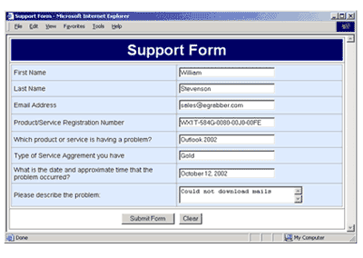
System Testing
Website forms
Forms are the text boxes, list boxes, and other fields for entering and selecting information on the web page.
Are the form fields positioned properly?
Are the fields the correct size?
Do they accept correct data?
Do they reject bad data?
Are optional fields really optional?
A favorite entry point for buffer overflow attacks.

Slide 41
System Testing
“Grey-box” testing
A mixture of white-box and black-box testing.
You stick to black-box testing primarily and supplement it by taking a peek at the HTML to figure out how the website works.
For website testing it is worth looking at the HTML code.
It’s there, easy to look at, why not?
Not looking at the HTML code is wasteful, especially since HTML is such a simple language.
HTML is a tagging language for text and graphics.
To create dynamic web content requires that HTML be supplemented by programming code (e.g., Java applets, ActiveX, VBScript, CGI, Perl).

Slide 42
System Testing
White-box testing
To make sure you find the important bugs you should have some knowledge of the website’s programming:
Dynamic content
Database-driven web pages
Programmatically created web pages
Server performance and loading and security

Slide 43
Dynamic content
Dynamic content is graphics and text that changes based on certain conditions.
E.g., time of day, weather, stock tickers
Client-side programming involve embedding scripting code (e.g., JavaScript) into HTML.
Less efficient if the computations are expensive
Code is local, easy to access for testing
Server-side programming is code located on the server.
More efficient for intensive calculations
Requires access to the web server to view the code (might be a problem for testing).

Slide 44
Database-driven web pages
Most E-commerce that show catalogs or inventories are database driven.
E.g., Amazon
Data is pulled from the database, formatted into HTML and sent to the web browser for viewing A three tier architecture is used:
Tier 1: web browsers (presentation)
Tier 2: web page formatter (converts data from Tier 3 to HTML)
Tier 3: database (queried by Tier 2)

Slide 45
Programmatically- Created web pages
HTML or code is generated by a program.
E.g., a web designer may drag and drop elements in a layout program, press a button, and get an HTML page.
Compilers do this all the time, except they translate high-level language code (Java source code) into low-level code that can be executed natively or on a VM (e.g., byte code).
Testing these systems is like testing a compiler …
Automation? (Selenium)

Slide 46
System Testing
Server performance loading and security
Popular websites can receive millions of hits per day.
www.youtube.com hits 100 Million Videos per day
Each hit requires a download of data from the website’s server to the browser’s computer.
You need to simulate millions of connections and downloads to test a system for performance and loading.
Security issues include:
Denial of service attacks
Buffer overflow attacks

Slide 47
Configuration and compatibility testing
Hardware platform
Mac, PC, PDA, WiFi wristwatch?
Browser software version
Firefox 1.0, IE 6.0, Pocket IE, Netscape 7.2, Safari 2.0.4
Browser plug-ins
To play specific types of audio or video files
Browser options
Security options, ALT text, plug-in, pop ups
Video resolution and color depth
640x480, 800x600, 1024x768, 1280x1024, 256 colors, 16 colors
Text size
Small fonts, medium fonts, large fonts
Connection speed
DSL, modems of varying speed.

Slide 48
System Testing
Usability testing: Jacob Nielsen’s top 10 mistakes in web design
Gratuitous use of bleeding-edge technology
Scrolling text, marquees, and constantly running animations
Long scrolling pages
Non-standard link colors
Outdated information (need website maintenance)
Overly long download times (more than 10 sec to load)
Lack of navigation support
Orphan pages
Complex website addresses (URLs)
Using Frames (just open another window …)

Slide 49
System Testing
Website testing tools
Check out www.netmechanic.com
Website testing is very labor-intensive.
Tools that automatically check websites for:
Browser compatibility
Performance problems
Broken hyperlinks
HTML standard adherence
Spelling on text

Slide 50
System Testing
What type of bugs? Study by Kallepalli and Tian [IEEE TSE].
Analyzed the logs of the Web pages of Southern Methodist University for usage and failure information.
Looked at data from 26 consecutive days.
Total number of “hits” 762,971 (~30,000 hits/day)
A “hit” is registered for each Web page if one of the following happens:
The HTML file corresponding to a page is requested.
Any graphics within the HTML page is requested.

Slide 51
Bug types
Permission denied
No such file or directory
Stale NFS handle
Client denied by server configuration
File does not exist
Invalid method in request
Invalid URL in request connection
Mod_mime_magic
Request failed
Script not found or unable to start
Connection reset by peer
2079
14
4
2
28631
0
1
1
1
27
0

Slide 52
System Testing
About the bugs
“Permission denied”
Unauthorized access to restricted resources
Is this a bug?
“File does not exist”
Wrongfully denied access to restricted or unrestricted resources e.g., wrong file access code

Slide 53

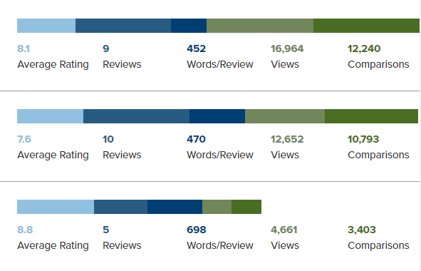
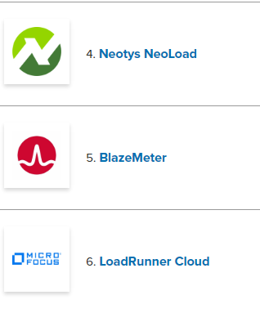
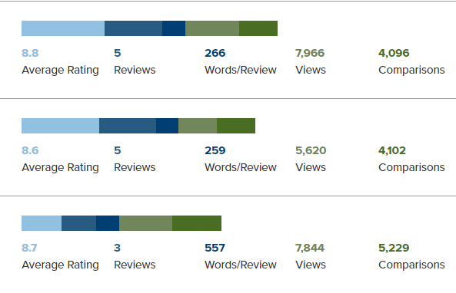
Test Tools

Slide 54
To be continued… See you next week

